Slide 1
Capstone Project : Predict Hospital Readmission for Patients with Diabetes
By: Jitendra Noutiyal
Date: 25th March 2023
Notes:
<a href="https://www.freepik.com/free-photos-vectors/people">People vector created by pch.vector - www.freepik.com</a>

Slide 2
Introduction
As the healthcare system moves toward value-based care, CMS has created many programs to improve the quality of care of patients. One of these programs is called the Hospital Readmission Reduction Program (HRRP), which reduces reimbursement to hospitals with above average readmissions. For those hospitals which are currently penalized under this program, one solution is to create interventions to provide additional assistance to patients with increased risk of readmission. But how do we identify these patients? We can use predictive modeling from data science to help prioritize patients.
One patient population that is at increased risk of hospitalization and readmission is that of diabetes. Diabetes is a medical condition that affects approximately 1 in 10 patients in the United States. According to Ostling et al, patients with diabetes have almost double the chance of being hospitalized than the general population (Ostling et al 2017). Therefore, in this article, I will focus on predicting hospital readmission for patients with diabetes.
Notes:
<a href="https://www.freepik.com/free-photos-vectors/medical">Medical vector created by freepik - www.freepik.com</a>

Slide 3
Building Model
In this project I will demonstrate how to build a model predicting readmission in Python using the following steps
1. data exploration
2. feature engineering
3. building training/validation/test samples
4. model selection
5. model evaluation
Notes:
<a href="https://www.freepik.com/free-photos-vectors/medical">Medical vector created by freepik - www.freepik.com</a>

Slide 4
Project Definition
Predict if a patient with diabetes will be readmitted to the hospital within 30 days.
Notes:
<a href="https://www.freepik.com/free-photos-vectors/medical">Medical vector created by freepik - www.freepik.com</a>

Slide 5
Project Definition
Data Exploration:
The data that is used in this project originally comes from the UCI machine learning repository. The data consists of over 100000 hospital admissions from patients with diabetes from 130 US hospitals between 1999–2008.
From briefly, looking through the data columns, we can see there are some identification columns, some numerical columns, and some categorical (free-text) columns.
There is some missing data that are represented with a question mark (?). We will deal with this in the feature engineering section.
The most important column here is readmitted, which tells us if a patient was hospitalized within 30 days, greater than 30 days or not readmitted.
Notes:
<a href="https://www.freepik.com/free-photos-vectors/medical">Medical vector created by freepik - www.freepik.com</a>

Slide 6
Feature Engineering
The missing numbers were filled with a question mark. I replaced it with a nan representation.
2. Categorical data : for modelling we want all numeric data so I used one hot encoding and bucketing for convert categorical into numerical.
3. After feature engineering I got 8 numerical feature , 133 categorical and 2 extra feature.
Used Pandas for feature engineering.
Notes:
<a href="https://www.freepik.com/free-photos-vectors/medical">Medical vector created by freepik - www.freepik.com</a>

Slide 7
Building Training/Test Samples
We split into three parts:
Training samples: these samples are used to train the model.
Test samples: these samples are held out from all decisions and are used to measure the generalized performance of the model.
In this project, we will split into 70% train and 30% test.
What is happening is that we have an imbalanced dataset where there are much more negatives than positives, so the model might just assign all samples as negative.
I used over-sample the imbalanced class: use the same positive samples multiple times.
After balancing data I got 50% positive data and 50%negative data for training.
Notes:
<a href="https://www.freepik.com/free-photos-vectors/medical">Medical vector created by freepik - www.freepik.com</a>

Slide 8
Model Selection
In this section, we train a few machine learning models and use a few techniques for optimizing them. We will then select the best model based on performance on the validation set.
Model Selection: Baseline models
In this section, we will first compare the performance of the following 7 machine learning models using default hyper parameters:
K-nearest neighbours
Logistic regression
Stochastic gradient descent
Naive Bayes
Decision tree
Random forest
Gradient boosting classifier
Notes:
<a href="https://www.freepik.com/free-photos-vectors/medical">Medical vector created by freepik - www.freepik.com</a>

Slide 9
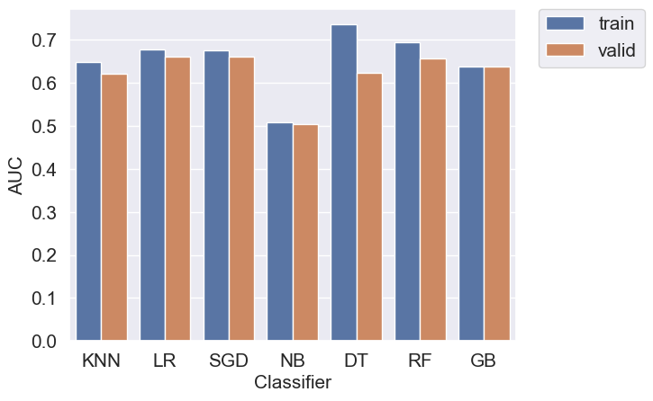
Project Definition
Using default parameter I got results of
Recall, precision and accuracy from all models.
I Found Random forest recall value is giving much better than other model so I tuned Hyper parameter and implemented my model using Random Forest.
Before tuning result from Random forest:
Accuracy: 75%
Precision:14%
Recall:22%
Notes:
<a href="https://www.freepik.com/free-photos-vectors/medical">Medical vector created by freepik - www.freepik.com</a>

Slide 10
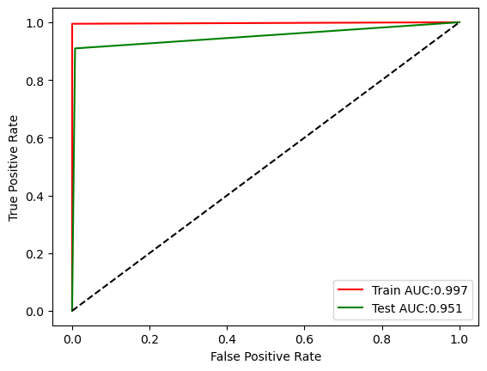
Hyper parameter tuning
After tuning Randome forest classifier we got below results for test data.
Accuracy: 98%
Precision: 93%
Recall: 91%
2. I Checked using AUC and found 95% data recall by model.
Notes:
<a href="https://www.freepik.com/free-photos-vectors/medical">Medical vector created by freepik - www.freepik.com</a>

Slide 11
Conclusion
1. Model predicted 90% data who is readmitting in 30 days with diabetic disease.
2. Found 84% population gender is female.
3. Found 89% patient are not admitted as compare to 11% with diabetes disease readmission rate is more.
Notes:
<a href="https://www.freepik.com/free-photos-vectors/medical">Medical vector created by freepik - www.freepik.com</a>

Slide 12
THANK
YOU

